Slide 1
Introduction to Groundwater Modeling and MODFLOW

Slide 2
What is your perspective on interaction of GW and SW?
How does GW/SW interaction influence the groundwater flow system?
or
How does GW/SW interaction influence the surface-water flow system?

Slide 3
Surface-water hydraulics simulation model program
Black Box

Slide 4
Groundwater Flow Model
Surface-water processes

Slide 5
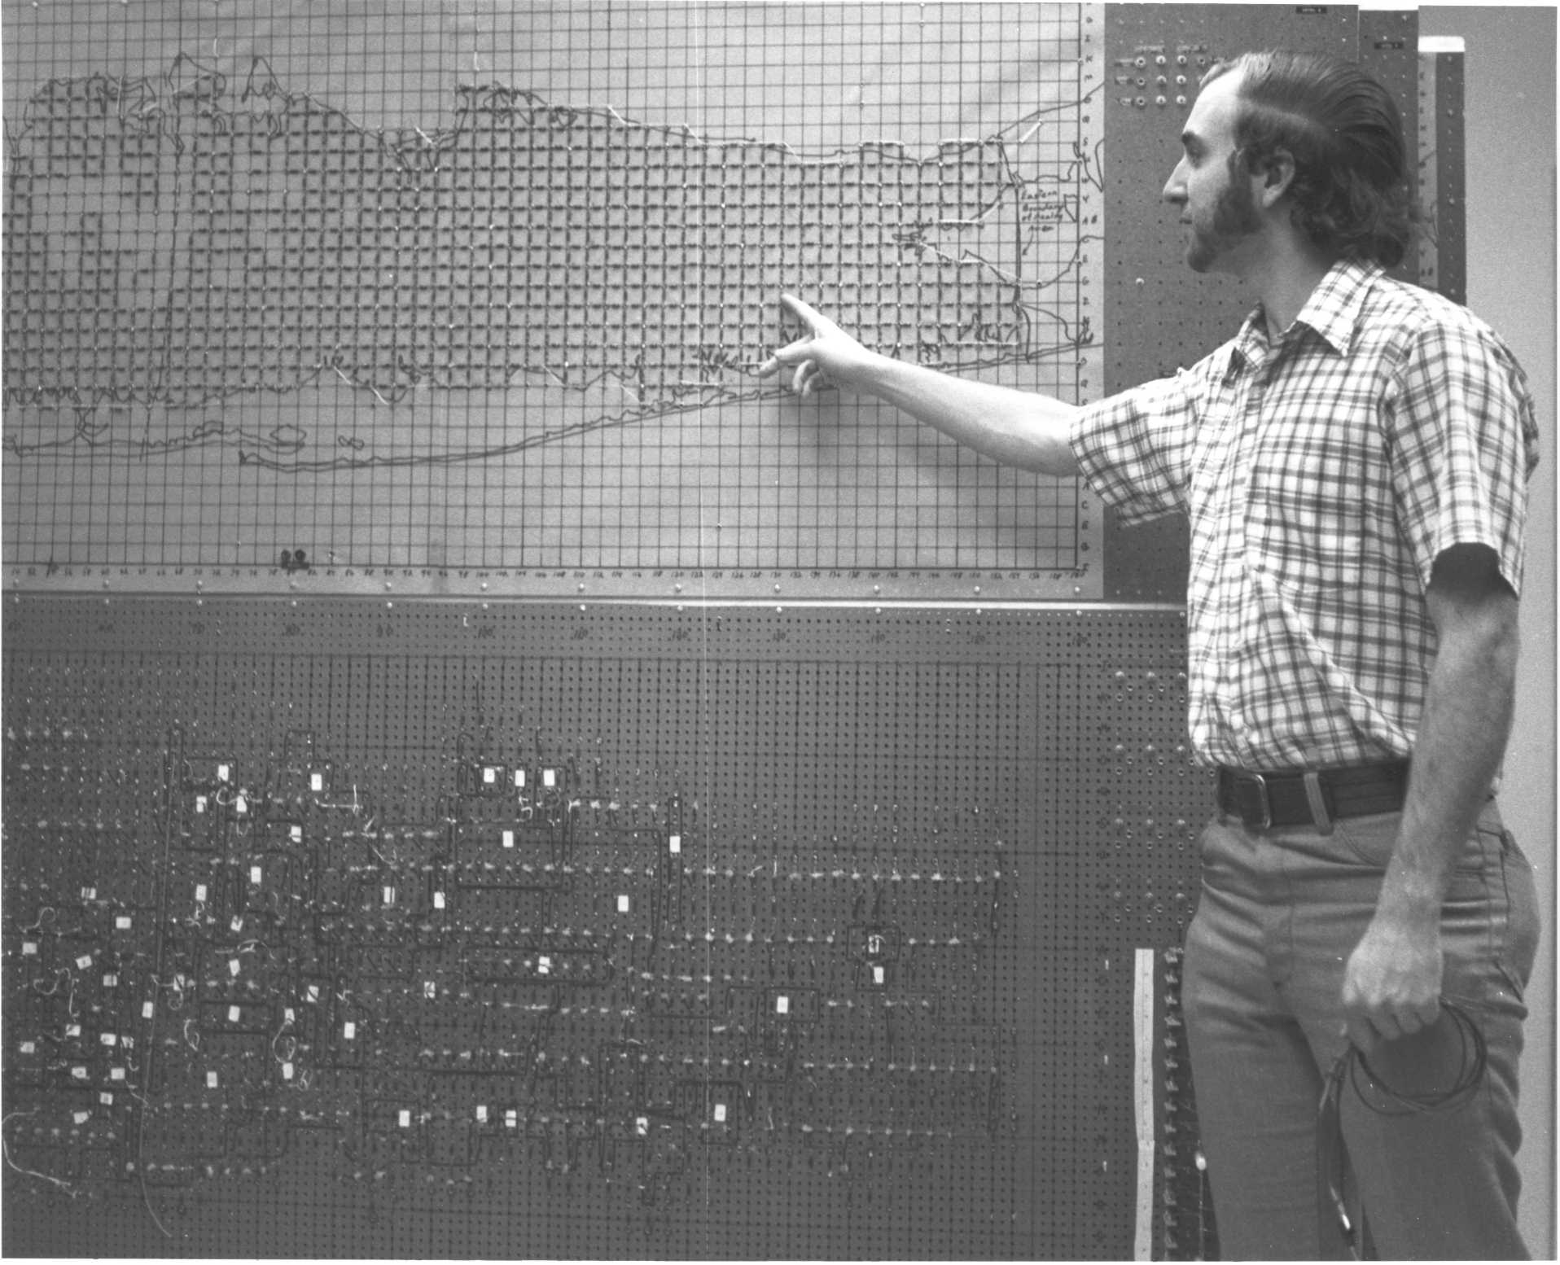
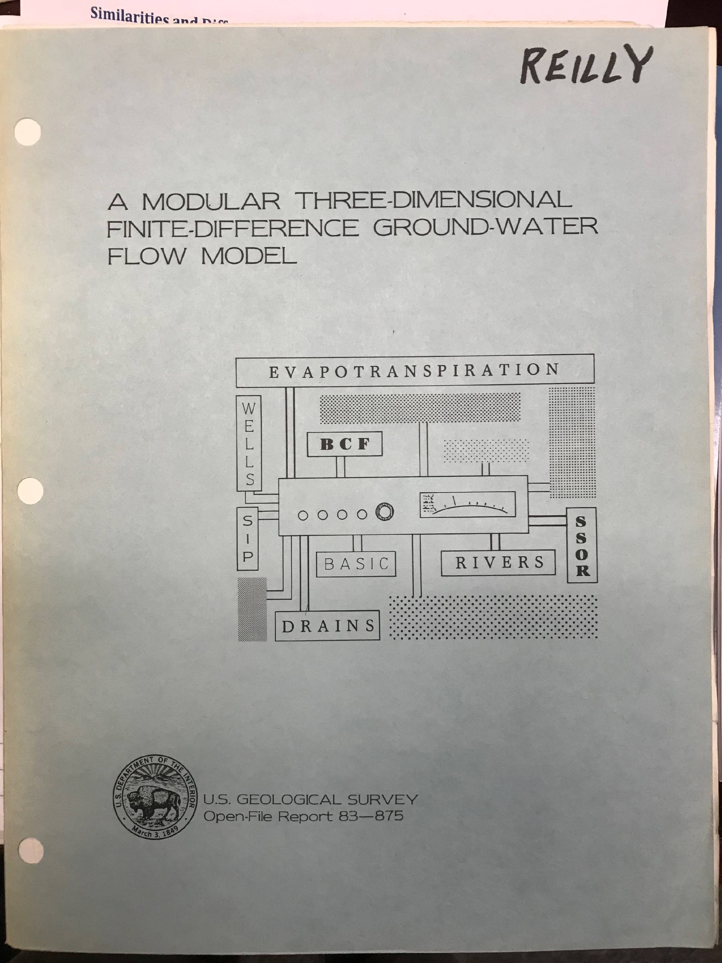
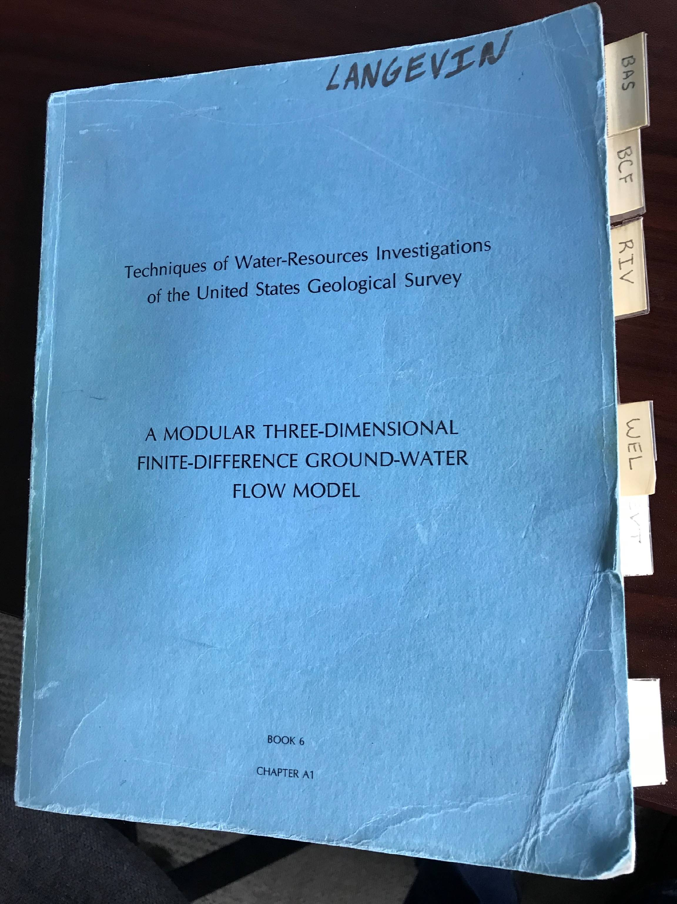
MODFLOW

Slide 6
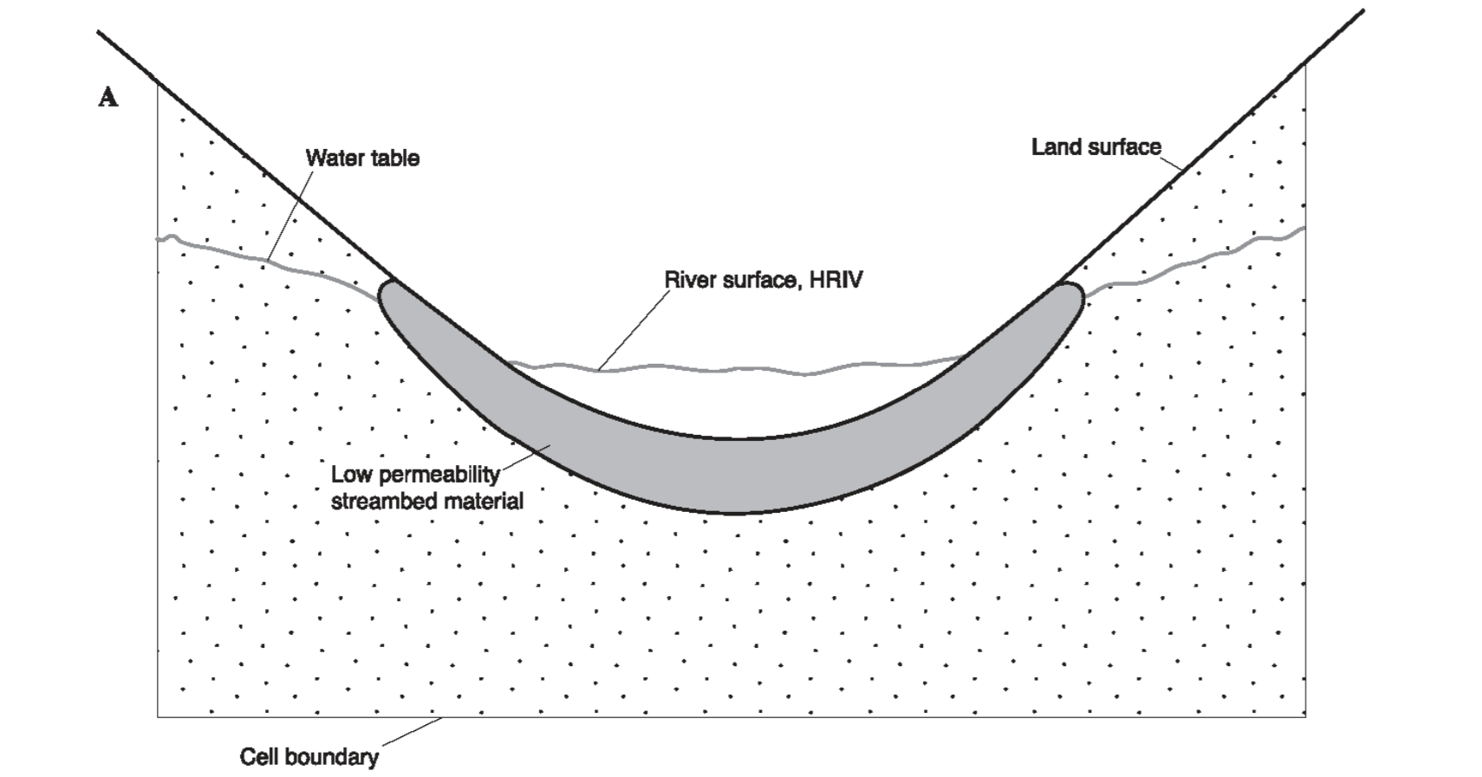
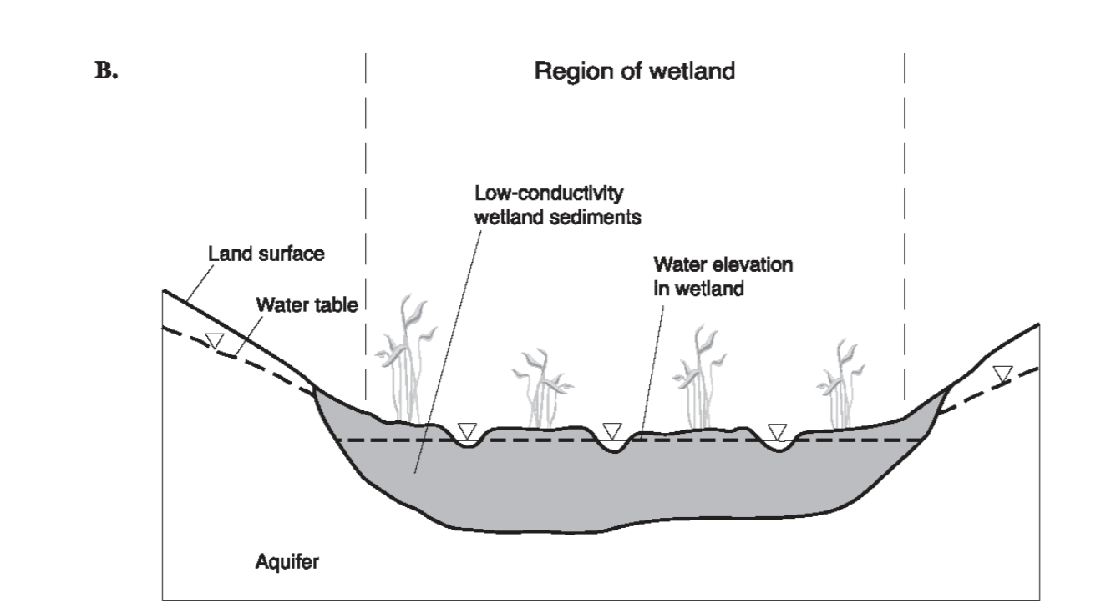
Important Note about Why MODFLOW is Unique
Rather than describing groundwater boundary conditions mathematically as “Neumann” or “Dirichlet,” they were described conceptually as “RIVER,” “ET,’ or “DRAIN.”

Slide 7
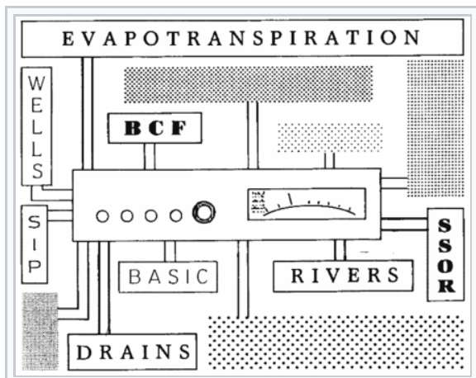
Modular MODFLOW ahead of its time
Design code to resemble the concept of a modular stereo system.
“Plug” in new components (packages) to enhance capabilities

Slide 8
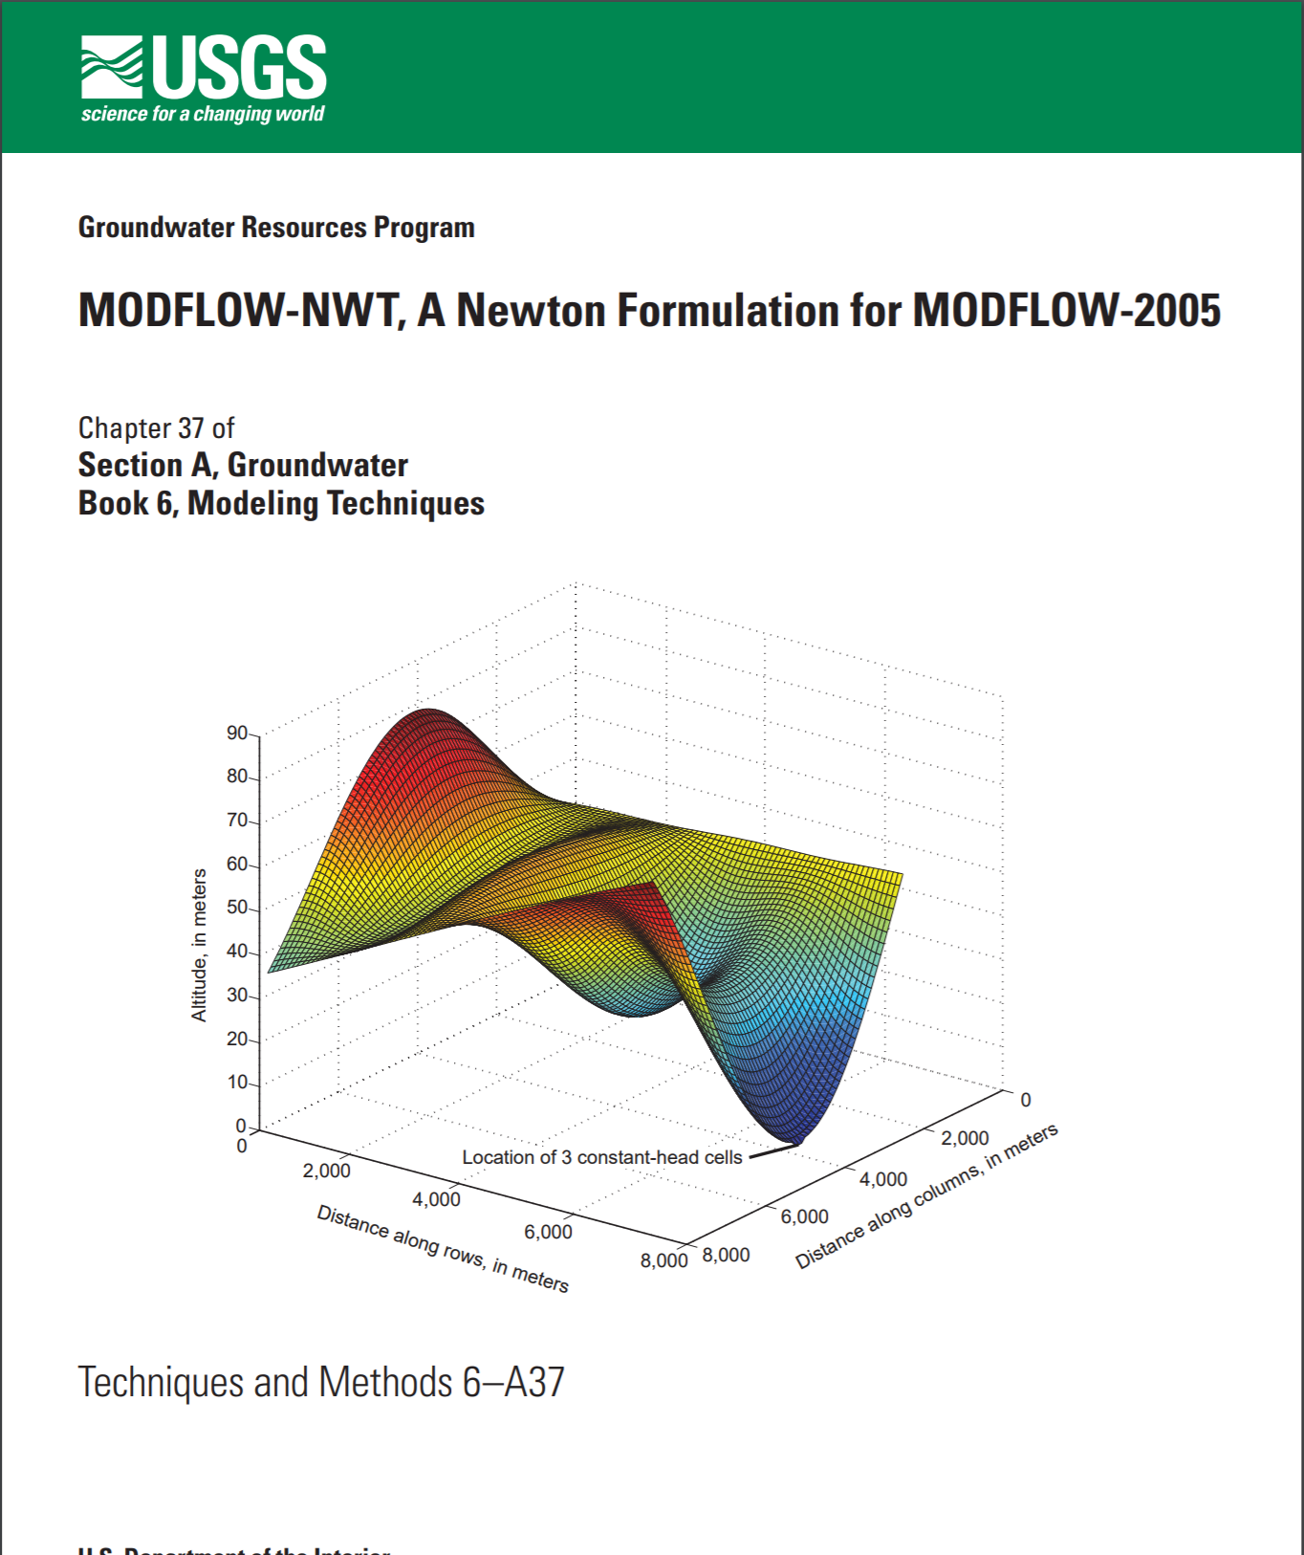
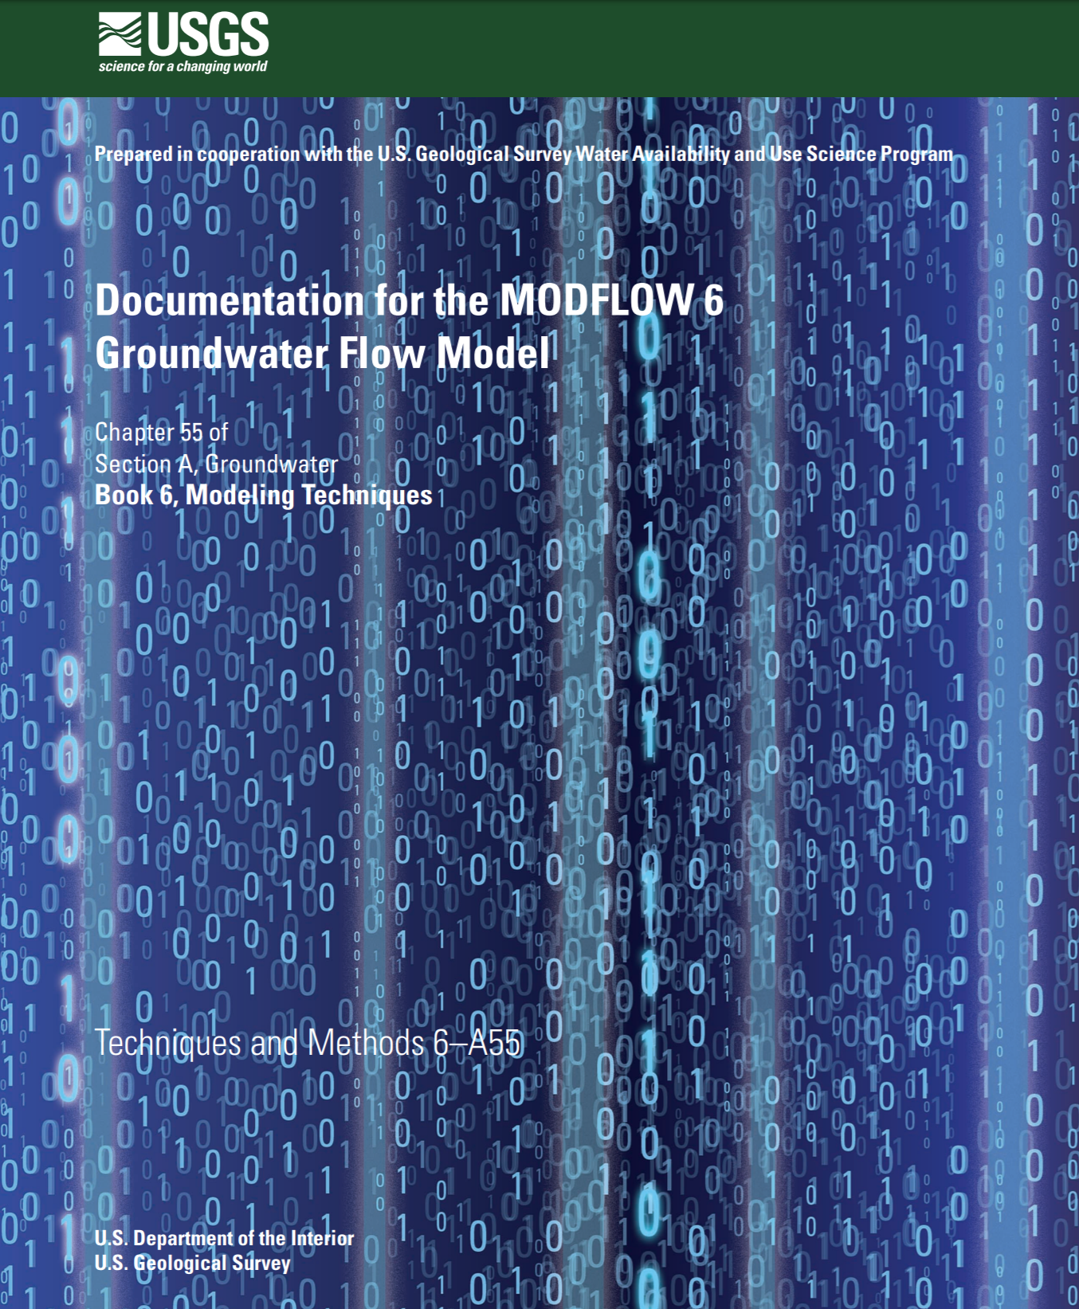
MODFLOW
MF-NWT+PRMS5
MF6+PRMS6

Slide 9



Groundwater Flow Equation
The equation is an expression of mass balance, referred to as a continuity equation
Darcy’s Law:
$$q_{x}=K_{xx}\frac{∂h}{∂x}$$
Relative elementary
volume of aquifer
$$q_{y}=K_{yy}\frac{∂h}{∂y}$$
~cm
$$q_{z}=K_{zz}\frac{∂h}{∂z}$$

Slide 10


Conservative form of 3D Groundwater Flow Equation
$$∆v$$
$$∆c$$
Darcy’s Law
Notes:
Control volume finite difference (volume averaging, Whitaker, UCD)

Slide 11

Groundwater Flow Equation, “W” term
The “W” term is the flow rate added
to or taken from groundwater system.
W=$Q_{1}+Q_{2}$+ $Q_{3}$+… $Q_{n}$
Q₃
Q₁
Q₂
MODFLOW cell
Most interaction between groundwater and surface water is lumped into the W term

Slide 12

Volume Averaged (Conservative) Groundwater Flow Equation
Finite differences are applied to this equation:
USGS
science for a changing world

Slide 13
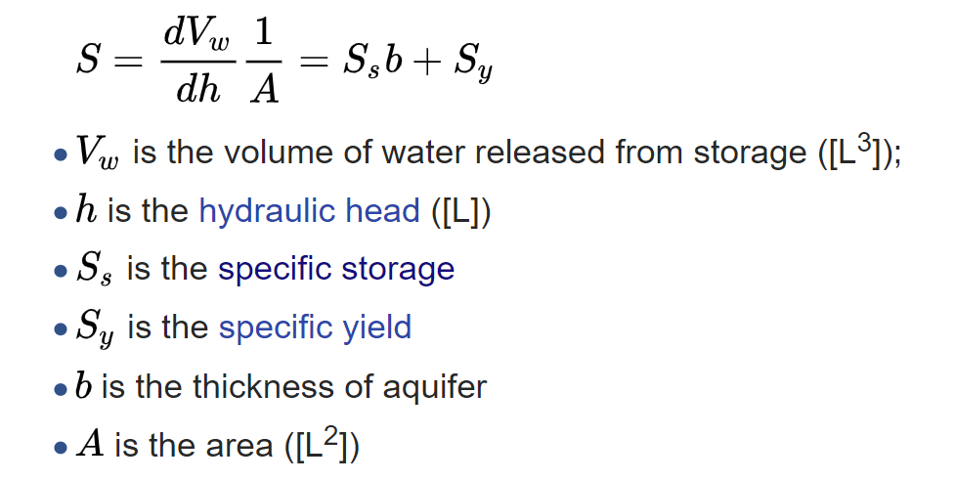
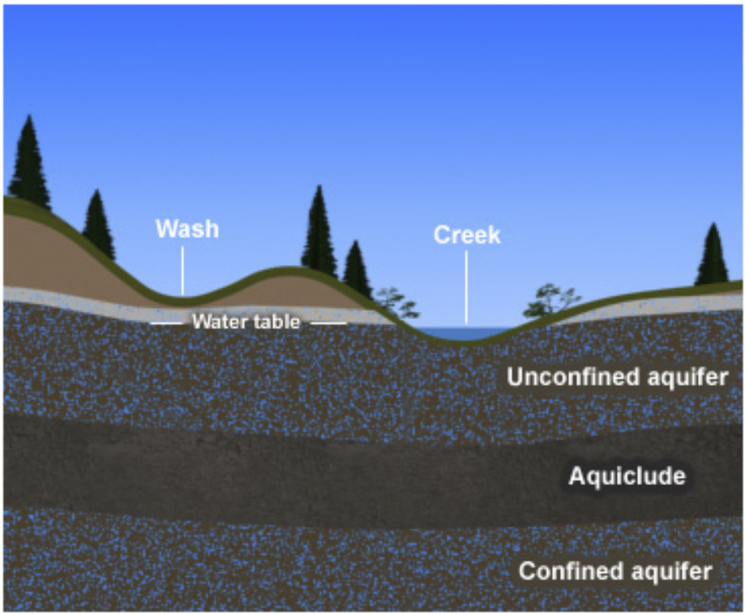
Aquifer Storage

Slide 14
Groundwater Flow Quiz
Below are hydrographs from three different observation wells. Carefully inspect the hydrographs and make a judgment as to whether steady-state or transient groundwater flow conditions prevail.
Well A
Steady state
HEAD
Transient
TIME
Well B
Steady state
HEAD
Transient
TIME
Well C
Steady state
HEAD
Transient
TIME

